Slide 1
E-retail factors for customer activation and retention: A case study from Indian e-commerce customers
Presentation on
Submitted by:
Saraswathy L
Data Science Intern
Flip Robo Technologies

Slide 2
Introduction:
Business Problem Framing:
Customer satisfaction has emerged as one of the most important factors that guarantee the success of online store; it has been posited as a key stimulant of purchase, repurchase intentions and customer loyalty.
A comprehensive review of the literature, theories and models have been carried out to propose the models for customer activation and customer retention.
Five major factors that contributed to the success of an e-commerce store have been identified as: service quality, system quality, information quality, trust and net benefit. The research furthermore investigated the factors that influence the online customers repeat purchase intention. The combination of both utilitarian value and hedonistic values are needed to affect the repeat purchase intention (loyalty) positively. The data is collected from the Indian online shoppers. Results indicate the e-retail success factors, which are very much critical for customer satisfaction.

Slide 3
Introduction
Conceptual Background of the Domain Problem
Customer retention refers to the ability of a company or product to retain its customers over some specified period. High customer retention means customers of the product or business tend to return to, continue to buy or in some other way not defect to another product or business, or to non-use entirely. Selling organizations generally attempt to reduce customer defections. Customer retention starts with the first contact an organization has with a customer and continues throughout the entire lifetime of a relationship and successful retention efforts take this entire lifecycle into account. A company's ability to attract and retain new customers is related not only to its product or services, but also to the way it services its existing customers, the value the customers actually perceive as a result of utilizing the solutions, and the reputation it creates within and across the marketplace.

Slide 4
Motivation for the Problem Undertaken
Successful customer retention involves more than giving the customer what they expect. Generating loyal advocates of the brand might mean exceeding customer expectations. Creating customer loyalty puts 'customer value rather than maximizing profits and shareholder value at the centre of business strategy'. The key differentiation in a competitive environment is often the delivery of a consistently high standard of customer service. Furthermore, in the emerging world of Customer Success, retention is a major objective.

Slide 5
Diagrammatic Representation of Customer Retention
The hedonic value has 5 values: gratification, role, best deal, social, adventure.
The Utilitarian have four values: Product offering, Convenience, Product Information, Monetary Saving.
The customer retention is based on three main factors: Hedonic value, Perceived Risk, Utilitarian

Slide 6
Hardware and Software Requirements and Tools Used:
Hardware Used:
RAM: 8 GB
CPU: AMD A8 Quad Core 2.2 Ghz
GPU: AMD Redon R5 Graphics
Software Tools used:
Programming language: Python 3.0
Distribution: Anaconda Navigator
Browser-based language shell: Jupyter Notebook
Libraries/Packages Used:
Pandas
Numpy
Matplotlib
Seaborn

Slide 7
Analytical Problem Framing:
Mathematical/ Analytical Modelling of the Problem :
The dataset is being provided by Flip Robo Technologies in .xlsx (Microsoft Excel) format and contains 269 records with 71 features.
We began with loading the dataset and reading the dataset from the xlsx file using the read_excel() function from the Pandas Python package. Next, we performed Non-Graphical Exploratory Data Analysis (EDA) such as checking the data types and missing values using pandas info() function.
Later, we performed graphical EDA to get more insights from our dataset.

Slide 8
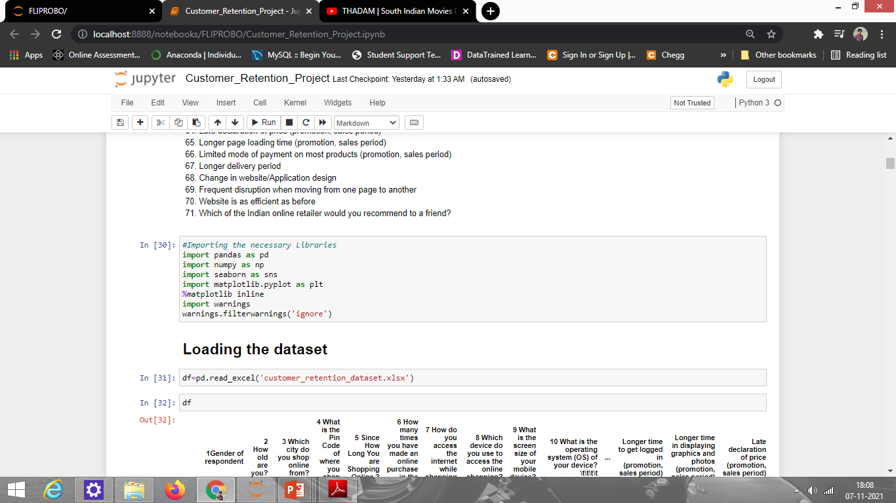
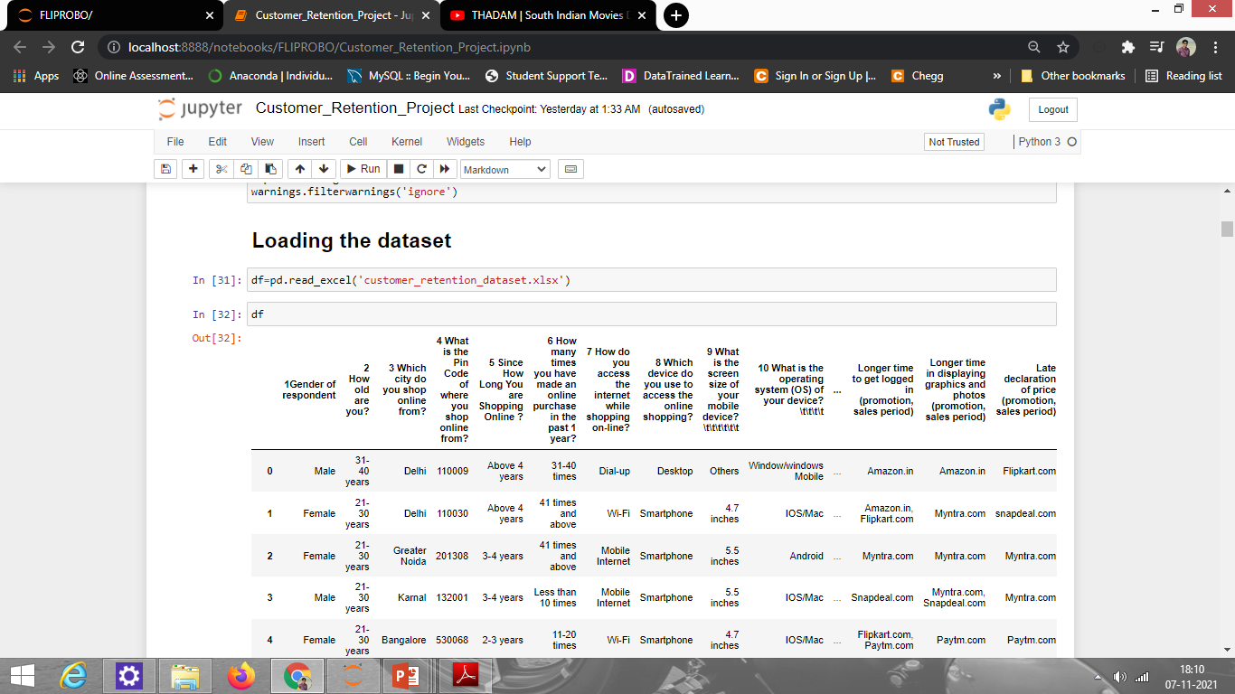
Working with the Dataset
Importing Libraries/Packages
Loading the dataset:

Slide 9

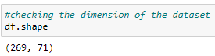
Data Sources and their formats
Observation:
Data has 269 rows and 71 columns

Slide 10
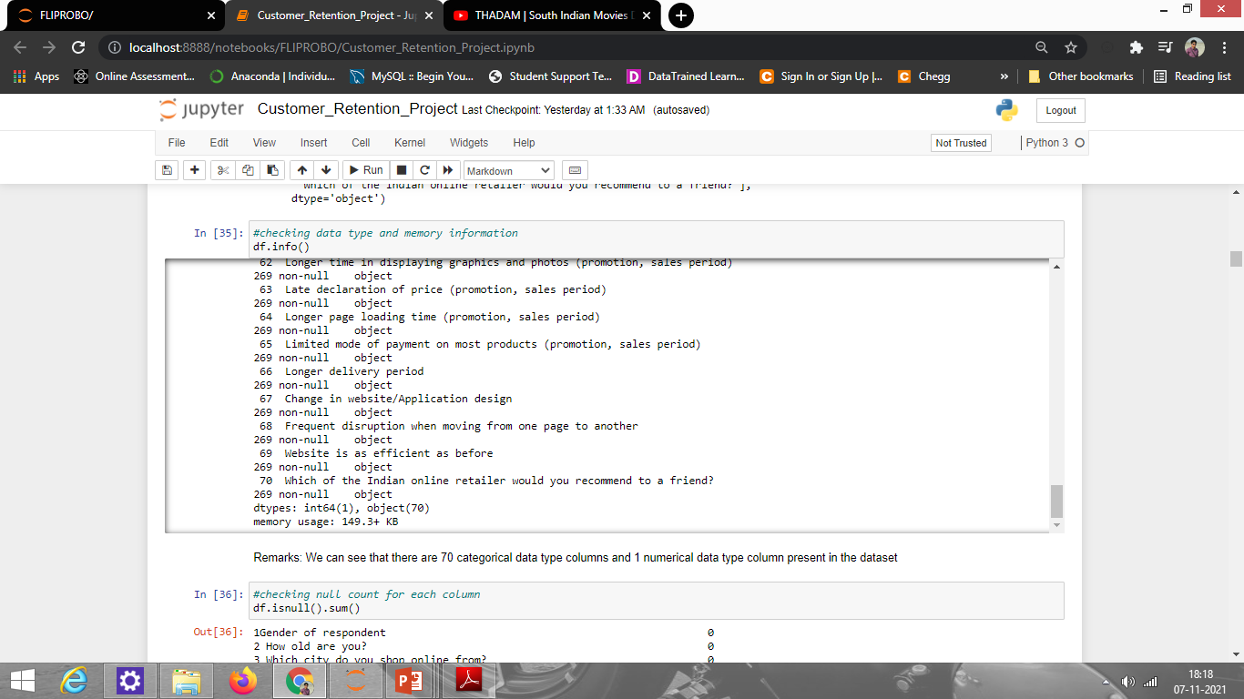
Data type Information:
Observations:
There are 1 numerical column and 70 categorical columns

Slide 11
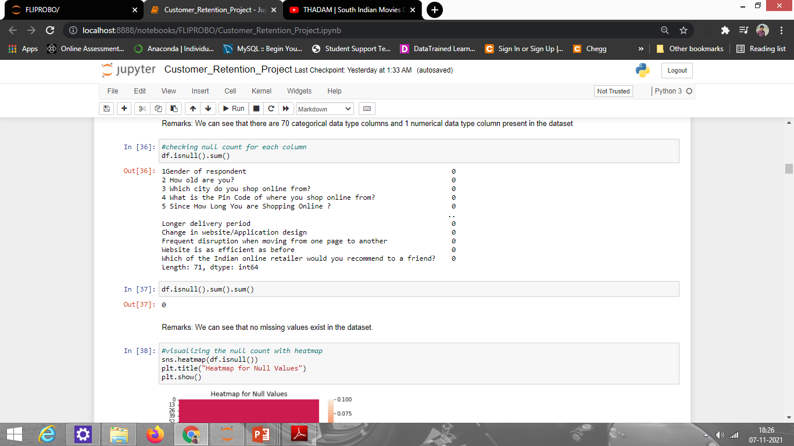
Missing Values In dataset
Observation:
There are no missing values present in the dataset.

Slide 12
Visualizations:
To better understand the data, the following types of visualizations have been used: 1. Univariate, 2. Bivariate.
Univariate Analysis: Univariate analysis is the simplest form of data analysis where the data being analyzed contains only one variable. In this project analysis, I have used count-plot because it helped to understand each feature of data like people of which age used which site more, which type of device more to order any product, and people of which age or gender researched about the product before buying it, etc.

Slide 13
Univariate Analysis:
Some of the count-plots and the observations made from them are shown.
Observation:
1. From the count plot of gender, we can say male customers are fewer while female customers are more which means females use to do more shopping
2. From count plot of age, we see that 21-30 years and 31-40 years of people use to do more shopping and people who are 51 years and above use do very less shopping

Slide 14
Observation:
1. From Since How Long You are Shopping Online plot, we can say since the age of 4+ people has started to shop online.
2. From How many times you have made an online purchase in the past 1 year? plot, we can say less than 10 times has high count, and 42 times and above have least count. It means that most people do online purchase less than 10 times a year.

Slide 15
Observation:
1. From How do you access the internet while shopping online? plot, we can see people use to shop using mobile internet more and very few use dial-up.
2. From Which device do you use to access online shopping? plot, we can say people use their smartphones more than laptops, and very few uses tablet.

Slide 16
Observation:
1. From What browser do you run on your device to access the website? plot, we can say the majority of people use Google chrome and very few people use Firefox.
2. From Which channel did you follow to arrive at your favourite online store for the first time? plot, we see that People mostly use the search engine to buy something.

Slide 17
Observation:
From the plot, we see that paytm.com takes the longest time to deliver items followed by snapdeal.com, flipkart.com then Amazon.com. Myntra.com takes the least time to deliver products.

Slide 18
Observation:
From the plot, we can say Delhi has the highest count which means that people in Delhi order more. After Delhi, Greater Noida has the 2nd highest count and Bulandshahr has the lowest count which means people who live in Bulandshahr usually buy fewer online items.

Slide 19
Observation:
From the plot, we can say Snapdeal has the highest limited mode of payment, and Paytm has the least.

Slide 20
Observation:
From the plot, we can say Amazon.com provides the fastest delivery.

Slide 21
BIVARIATE ANALYSIS
Bivariate analysis is one of the simplest forms of quantitative analysis. It involves the analysis of two variables to determine the empirical relationship between them. We have analyzed the data and its relationship with features using a strip plot.
Strip plot helped to find out how different ages of people order their product, which age of people uses which site more, etc.
We have done EDA on age vs all the features to understand how can sites improve their service for different ages people.
After analysis, we understood that most 21-40 age people order more and spend their time on different sites to check products.

Slide 22
Some of the plots showing the relationship of Age with all the other features
Observation:
From the age vs gender plot, we can say for every age from young to old, females are more as compared to males

Slide 23
Observation:
1. From age vs Since How Long You are Shopping Online? plot, we can say the people who are doing shopping for above 4 years are mostly in age between 31-50 years, and the people who are in 3-4 years values are 21-30 years of age; with 2-3 years are mostly belonging to the age group 41-50 years and the people who are in less than 1 year are 31-40 years of age
2. From age vs How many times you have made an online purchase in the past 1 year? plot, we can say most people who have ordered 31-40 times in a year falls into 41-50 age group; with 41 times and above have the age of 21-30 years; less than 10 times are in 21-50 age group, and 11-12 times are in the age between 21-30 years, so we can summarise that mostly 21-30 years of people are shopping more.

Slide 24
Observation:
1. From age vs How do you access the internet while shopping online? plot, we can say that some people use dial-up having age 31-40 years; and from wifi use, we can say all of the people use wifi but 21-40 age of people use it more. From mobile internet, we can say mostly 21-50 age of people use it more as compared to others.
2. From age vs Which device do you use to access online shopping? plot, we can say people having age between 41-50 mostly use desktop and people whose age is between 21-40 years use mobile; some people use tablet having age of 41-50 years; some people use laptop have their age between 21-50 years, so we can say mostly above 41 years people use less mobile to order online, and some young people use mobile-only falls into age between 21-40years.

Slide 25
Observation:
1. From age vs What browser do you run on your device to access the website? plot, We can say people who have the age of 21-50 years everyone use Google chrome and fewer people use it who have age below 20 and 51+ years; people use safari more who have the age of 21-30 years, people with age 31-40 years also use it but have less count as compared to 21-30; there are only a few people who use opera having age of 21-30 years and very few people who use it have age of41-50 years; people use firefox who have age of 21-30 years more and very few uses it having age between 31-40 years.
2. From age vs Which channel did you follow to arrive at your favorite online store for the first time? plot, we can say people of every age use search engine but fewer people use it whose age is below 20 or above 51 years as compared to people of age between 21-50 years; and a few people use content marketing as compared to others who have age between 21-30 years; and some people use display advertise who have the age of 41-50 years.

Slide 26
Observation:
1. From age vs After first visit, how do you reach the online retail store? plot, we can say that people who have the age of 31-40 years reach the store by the search engine as compared to others; people who have the age of 21-50 years reach the store by application, and people who have the age of 31-40 years and below 21 have very less count as compared to others who reach the store by using direct URL, and people having ages between 41-50 and 51+ years mostly use email to reach the store.
2. From age vs How much time do you explore the e- retail store before making a purchase decision? the plot, we can say people who are having age of 21-50 years have explored the store between 6-10 minutes; those having age between 21-51+ years have explored the store for more than 15 minutes; those having age below 20 years gave explored the store for 1-5 minutes; there are some people having age between 31-40 years have exploded it for less than a minute.

Slide 27
Observation:
From age vs What is your preferred payment Option? plot, we can say people whose age is between 31-50 years used e-wallet more as compared to others; people who have age 21-30 and 41-50 years used credit cards more, and people who have the age of 31-40 years also used credit card but have less count. From the cash on delivery option, we can say all the people use to take this option but people of 21-40 years of age have high count as compared to others.

Slide 28
Some of the plots showing the relationship of All Site vs terms of different sites
Observation:
1. From Site vs The content on the website must be easy to read and understand plot, we can say every site strongly agree except for Paytm.
2. From Site vs Information on similar product to the one highlighted is important for product comparison, we see that Paytm disagrees while amazon, Flipkart, and Snapdeal strongly agree.

Slide 29
Observation:
1. From site vs Complete information on listed seller and product being offered is important for a purchase decision, Paytm disagree and other sites agree.
2. From site vs All relevant information on listed products must be stated clearly, Paytm disagree and others agree.

Slide 30
Observations:
From the plot, We can see that Amazon.com has got the highest positive review as well as a highest negative review, but positive reviews has a high count as compared to negative reviews; similar is the case with Flipkart.com and Myntra.com, while paytm.com and snapdeal.com have got lesser positive reviews and higher negative reviews.

Slide 31
Interpretation of the Results / Conclusion:
Starting with univariate analysis, we found that the dataset is imbalanced by analyzing the count-plot of Feature 1: Gender of respondent which consists of a fewer number of Male and a higher number of Females. This needs to be handled during the train test split part of model training.
Next, we moved on to Bivariate analysis and performed EDA on various features to have a better understanding of the data.
Lastly, we checked what people are saying about their online shopping experience on various sites and the suggestions they are making for a smooth online shopping experience.

Slide 32
The list of positive and negative reviews about various sites
Amazon.com:
Negative Reviews:
Takes a longer time to log in
Takes longer time in displaying graphics and photos
Late declaration of price
Takes Longer page loading time
More payment options required
Takes Longer delivery period
Positive Reviews:
Easy to use website or application
Visual appealing web-page layout
Wild variety of products on offer
Complete, relevant description information of a product
Fast loading website speed of the website
Reliability of the website or application
Quickness to complete purchase
Availability of several payment options
Speedy order delivery
Privacy of customers’ information
Security of customer financial information
Perceived Trustworthiness
Presence of online assistance through multi-choice
Website is as efficient as before.

Slide 33
Flipkart.com
Positive reviews:
Easy to use website or application
Visual appealing web-page layout
Wild variety of products on offer
Complete, relevant description information of a product
Fast loading website speed of the website
Reliability of the website or application
Quickness to complete purchase
Availability of several payment options
Speedy order delivery
Privacy of customers’ information
Security of customer financial information
Perceived Trustworthiness
Presence of online assistance through multi-choice
Website is as efficient as before
Which of the Indian online retailer would you choose
Negative Reviews:
Longer time to get logged in
Longer time in displaying graphics and photos
Late declaration of price
Longer page loading time
Limited mode of payment on most products
Longer delivery period
Change in website/Application design
Frequent disruption when moving from one page to another

Slide 34
Paytm.com:
Positive reviews with count:
Easy to use website or application - 125
Visual appealing web-page layout - 67
Wild variety of products on offer - 20
Complete, relevant description information of product - 59
Fast loading website speed of website - 99
Reliability of the website or application - 96
Privacy of customers’ information - 68
Security of customer financial information - 88
Perceived Trustworthiness - 24
Presence of online assistance through multi-choice - 25
Website is as efficient as before - 58
Which of the Indian online retailer would you choose - 44
Negative Reviews with count:
Longer time to get logged-in - 77
Longer time in displaying graphics and photos - 28
Late declaration of price - 72
Longer page loading time - 94
Limited mode of payment on most products - 53
Longer delivery period - 98
Change in website/Application design - 63
Frequent disruption when moving from one page to another - 39

Slide 35
Myntra.com
Positive reviews with count:
Easy to use website or application - 147
Visual appealing web-page layout - 115
Wild variety of products on offer - 64
Complete, relevant description information of product - 64
Fast loading website speed of website - 74
Reliability of the website or application - 64
Quickness to complete purchase - 79
Availability of several payment options - 132
Speedy order delivery - 29
Privacy of customers’ information - 78
Security of customer financial information - 91
Perceived Trustworthiness - 88
Presence of online assistance through multi-choice - 111
Website is as efficient as before - 14
Which of the Indian online retailer would you choose - 76
Negative Reviews with count:
Longer time to get logged-in - 35
Longer time in displaying graphics and photos - 74
Late declaration of price - 75
Longer page loading time - 68
Limited mode of payment on most products - 7
Longer delivery period - 26
Change in website/Application design - 37
Frequent disruption when moving from one page - 66

Slide 36
Snapdeal.com
Positive reviews with count:
Easy to use website or application - 130
Visual appealing web-page layout - 61
Wild variety of products on offer - 14
Complete, relevant description information of product - 59
Fast loading website speed of website - 81
Reliability of the website or application - 45
Availability of several payment options - 90
Speedy order delivery - 50
Privacy of customers’ information - 45
Security of customer financial information - 100
Website is as efficient as before - 25
Negative Reviews with count:
Longer time to get logged-in - 67
Longer time in displaying graphics and photos - 92
Late declaration of price - 0
Longer page loading time - 63
Limited mode of payment on most products - 109
Longer delivery period - 90
Change in website/Application design - 8
Frequent disruption when moving from one page to another - 74
NOTE:
All people are facing almost similar kind of problem with various sites. Here I have mentioned count so that if more people are facing similar count then the site should improve it, but if it has a less count then no need to do anything.

Slide 37
THANK YOU

